Slide 1

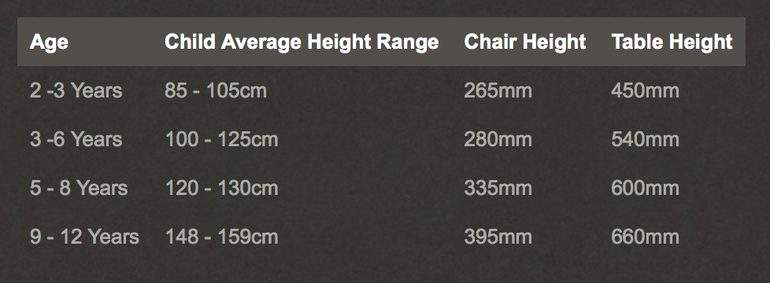
Weather and Calendar
Easel
Shelving with doors for teacher /center storage
Nursery Classroom
Teacher Chair
The carpet is where large group activities/teachings occur.
Reading/ listening Nook
Math center: Short circle table
Magazine Rack Book Shelf-short
Creative Center (short table and chairs) with cubby shelving for supply choices.
Dramatic Play Area:
Shelves for props
And rack for costumes

Slide 2
Whiteboard or Easel
Shelving with doors for teacher /center storage
PreUnit Classroom
READING NOOK
Meeting Carpet
M
A
T
H
STUDENT TABLE
SHORT
C
R
E
A
T
I
V
E
S
C
I
E
N
C
E
STUDENT TABLE
SHORT
STUDENT TABLE
SHORT

Slide 3
Class 1-3
Whiteboard or Easel
Shelving with doors for teacher /center storage
READING NOOK
S
T
A
T
I
O
N
STUDENT TABLE
STUDENT TABLE
STUDENT TABLE
STUDENT TABLE
S
T
A
T
I
O
N
S
T
A
T
I
O
N
STUDENT TABLE
STUDENT TABLE

Slide 4
Class 4-8
Whiteboard
BOOK
BOOK
C
O
R
N
E
R
STUDENT COLLABORATION SPACE
STUDENT TABLE
STUDENT TABLE
STUDENT TABLE
STUDENT TABLE
SCS- TALL TABLE, NO CHAIRS, WHERE STUDENTS CAN WORK ON GROUP PROJECTS.
STUDENT COLLABORATION SPACE
STUDENT TABLE
STUDENT TABLE
Shelving with doors for teacher /center storage

